Slide 1
When Your Dog Has Cancer: Making the Right Decisions for You and Your Dog
Canine Cancer Insights
Lola Ball
March 23, 2013

Slide 2
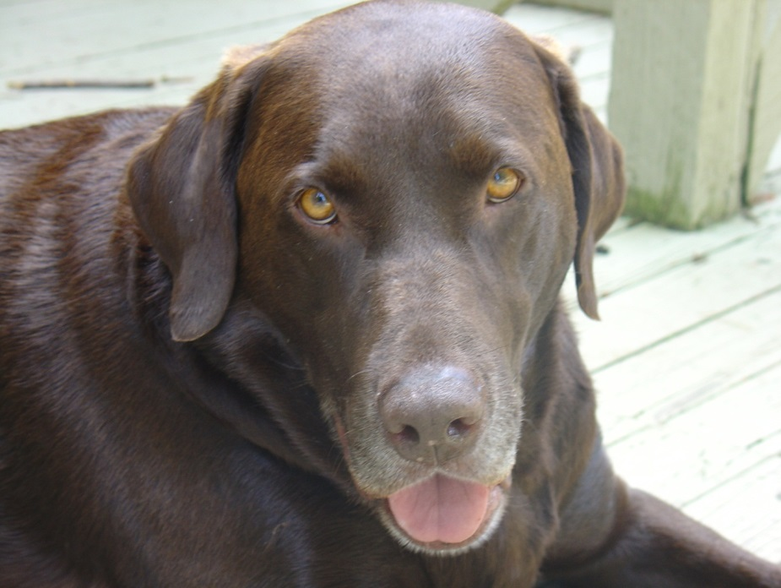
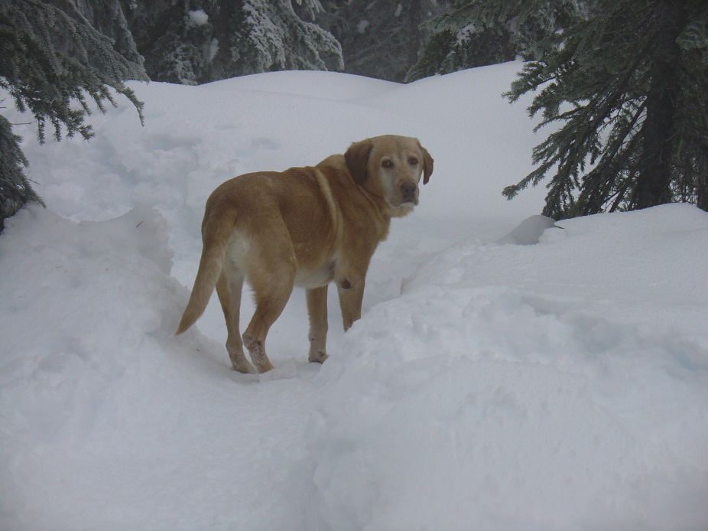
Dedication
He is your friend, your partner, your defender, your dog.
You are his life, his love, his leader. He will be yours, faithful and
true, to the last beat of his heart. You owe it to him to be worthy
of such devotion. ~ Unknown
Porter
Jasper

Slide 3
Agenda
The Cancer Diagnosis
Treatment Options
Hospice Care
High Quality of Life
Key Tips
Natural Dying Process
Q&A

Slide 4
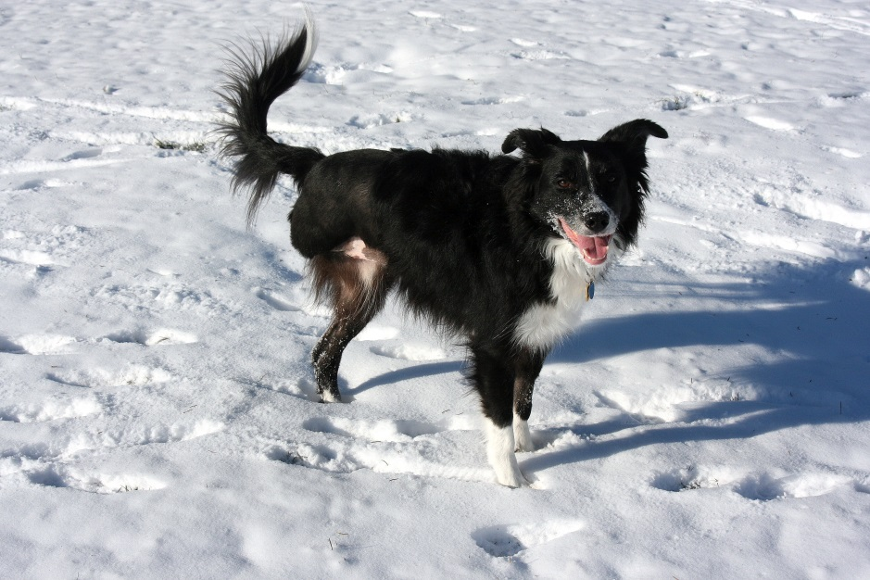
The Cancer Diagnosis
A diagnosis of cancer is overwhelming
Importance of having a baseline for your dog
What is normal for your dog?
What is abnormal?
Stories
Jasper
Kess
Tango
Kess, #2 Flying Disc Dog in WA State

Slide 5
Diagnostic Tests
Blood analysis
Urine analysis
X-rays
Ultrasound
Fine needle aspirate
Biopsy
Surgery
Increase in:
Invasiveness
Accuracy
Risk

Slide 6
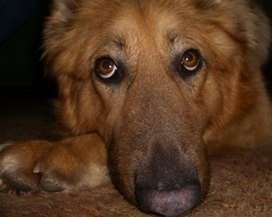
Catch it Early
Cancer is most easily treatable if caught early
Remember to have a baseline for your dog
Cancer can occur anywhere
And it doesn’t always present itself in the way you expect
Be hands-on with your dog, know their bodies
Trust your instincts, get second opinions
Try different laboratories for testing

Slide 7
Symptoms Can Appear Innocuous
Wounds that would not heal and associated lameness, i.e., Kess
Persistent coughing, i.e., Boomer
Unusual growths or unexplained skin conditions, i.e., Nelson
Sudden appearance of seizures
Sudden blindness, i.e., Putter
Appearance of blood in urine, i.e., Porter
Vomiting and lack of appetite, i.e., Jasper
Pain during normal everyday activities, like jumping or running, i.e., Alexsei
Sensitivity during physical examination, for example, rectal thermometer, i.e., Lewis

Slide 8
Treatment Options
Surgery – with margins
Chemotherapy – side effects, non-curative
Radiation therapy – intense treatment, specialized facilities
Immunotherapy/Genetic immunotherapy – uncommon, certain cancers only
Photodynamic therapy – uncommon, good for prostate
Antiangiogenic therapy – uncommon, not every cancer
Cryosurgery – surface tumors
Hyperthermia or thermal therapy – not readily available
Traditional Chinese Medicine – more palliative than curative
Supplemental treatments – more palliative than curative
Herbal supplements
Homeopathy
Energy medicine
…but there are always exceptions!

Slide 9
Explore Research and Clinical Trials
Animal Cancer Treatment Program, School of Veterinary Medicine, University of Wisconsin – Madison
Canine Health Foundation, American Kennel Club
Morris Animal Foundation of Colorado
Veterinary Teaching Hospitals
A list of current clinical trials can be found here: http://cancer.landofpuregold.com/trials.htm

Slide 10
What Questions Should You Ask?
What kind of cancer does my dog have?
What is the location, stage and grade of the tumor(s)?
What is the typical progression of this type of cancer and how will the progression of the disease manifest itself?
What are the associated risk factors and success rates of the recommended treatment?
Given your dog’s health history, age and other factors, what is the likely success rate of this treatment?
How much will the recommended treatment cost?
What is the state of your dog’s current health?
What is his/her health history, including previous and current illnesses?
What is your dog’s experience with previous surgeries? Does your dog handle anesthesia well? How has he responded to surgery in the past?

Slide 11
Hospice Care
Dame Cicely Saunders developed modern hospice principles in the 1950s
Hospice in animals is still evolving
IAAHPC Definition:
“Animal hospice is care for animals, focused on the patient’s and family’s needs; on living life as fully as possible until the time of death [with or without intervention]; and on attaining a degree of preparation for death.”

Slide 12
Perceptions of Death
Dr. Helene Starks of the University of Washington has evaluated the 1998 to 2006 statistics relating to the Death with Dignity Act in the state of Oregon
In 2007, less than sixteen in 10,000 terminally ill people in Oregon chose to take lethal medication
Perception != Reality

Slide 13
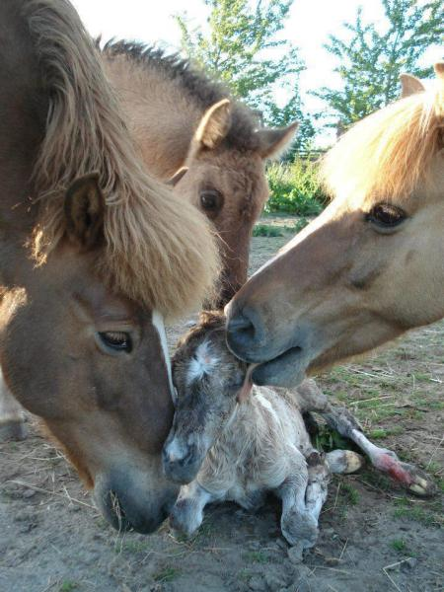
It Takes a Village…
An important element of hospice care is that you need to assemble your team
Primary veterinarian
Western
Eastern
Veterinary specialist
Massage therapist
Nutrition expert
Other

Slide 14
High Quality of Life
What is a high quality of life?
Physical indicators of happiness:
Tail wagging
Degree of playfulness
Strength of the human-canine bond
Good days versus bad days
Are there more good than bad?
Animals live in the moment and are not caught up in the how’s, where’s and why’s of dying

Slide 15
Determine Your Priorities
4 –
No Stress
3 – High Quality of Life
2 – High Quality Nutrition and Care
1 – No Pain
Provide pain management
Ensure proper nutrition and care
Provide as high a quality of life as possible in terms of physical comfort, exercise and playtime
Minimize stress

Slide 16
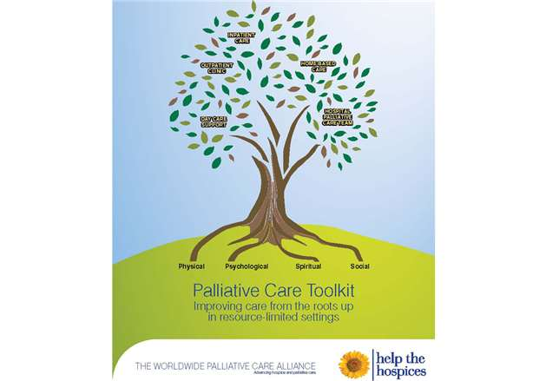
Create a Hospice Toolkit
Pain medications
NSAIDS, Tramadol, Acetaminophen, Neurontin, etc.
Alternative pain techniques
Castor Oil Wrap
Tellington Touch
Bach Flower Essences – Rescue Remedy
Control nausea and vomiting
Cerenia, Nux vomica, Ginger, Acupressure
Control diarrhea
Fast-Balance GI

Slide 17
Key Tips
Switch to the highest quality, natural dog food that you can afford
Organic fruits and vegetables
Organic ground beef, turkey, and chicken; wild fish
Limit grains
Maximize proteins and fats – cancer cells cannot process fat
Provide your dog with easy, unlimited access to filtered water
Ensure that your dog does not eat ANY SUGAR.
Cancer cells THRIVE on sugar. It is imperative that your dog does not ingest any sugar
Be flexible with your dog’s tastes; have several meal options available at each meal
If your dog has been on a raw food diet, some experts suggest light cooking to be more palatable and easier on digestive and immune systems.
Learn how to massage your dog
Think positive thoughts and create a loving atmosphere

Slide 18
Natural Dying Process
According to Tibetan Buddhism, there are eight stages of dying. The first four stages occur during what we Westerners would consider life, and the latter four stages occur after the final exhale from the body has occurred, during what we would consider death.
Stage 1
Days or weeks
Decline in the animal’s habits and daily functions takes place
Stage 2
Days or minutes
Water no longer desired; “last bloom”
Stage 3
Minutes
Shallow breathing, cease in digestion, colder body temperature
Stage 4
Minutes
Unaware of surroundings, infrequent breathing, twitching, howling, final fluid release, final exhale

Slide 19
Embrace Grief & Honor Memories
Dr. Elisabeth Kubler-Ross introduced five stages of grief in her book On Death and Dying
Denial
Anger
Bargaining
Depression
Acceptance
Many support resources are available
University of Tennessee, College of Veterinary Medicine, offers 4 free one-hour grief counseling sessions
Find a way to memorialize your beloved dog

Slide 20
Q&A
For more info, see my website at http://www.whenyourdoghascancer.org
Contact me at lola@alum.mit.edu

